Slide 1
Oracle Database Management Tools

Slide 2
Oracle Database Management Tools: Introduction
  SQL*Plus provides an interface to your database so that you can:
    Perform database management operations
    Execute SQL commands to query, insert, update, and delete data in your database
  SQL Developer
    Is a graphical user interface for accessing your instance of Oracle Database
    Supports development in both SQL and PL/SQL
    Is available in the default installation of Oracle Database
  Oracle Enterprise Manager Database Express
  Oracle Enterprise Manager Cloud Control
Notes:
SQL*Plus is a command-line program that you use to submit SQL and PL/SQL statements to an Oracle database. You can submit statements interactively or as SQL*Plus scripts. SQL*Plus is installed with the database and is located in your $ORACLE_HOME/bin directory.
You can start SQL*Plus from the command line, or from the Start menu on a Windows client.
SQL Developer is a graphical user interface for accessing your instance of Oracle Database. SQL Developer supports development in both the SQL and PL/SQL languages. It is available in the default installation of Oracle Database.
With SQL Developer, you can browse database objects, run SQL statements and SQL scripts, and edit and debug PL/SQL statements. You can also run any number of provided reports, as well as create and save your own.

Slide 3
Using SQL*Plus
SQL*Plus is:
  A command-line tool
  Used interactively or in batch mode
$ sqlplus hr
SQL*Plus: Release 12.1.0.2.0 Production on Mon Oct 6 13:28:12 2014
Copyright (c) 1982, 2014, Oracle. All rights reserved.
Enter password:
Last Successful login time: Mon Oct 06 2014 13:24:35 +00:00
Connected to:
Oracle Database 12c Enterprise Edition Release 12.1.0.2.0 - 64bit Production
With the Partitioning, OLAP, Advanced Analytics and Real Application Testing options
SQL> SELECT last_name FROM employees;
LAST_NAME
-------------------------
Abel
Ande
…
Notes:
You can use the SQL*Plus command-line interface to execute SQL*Plus, SQL, and PL/SQL commands to:
Enter, edit, run, store, retrieve, and save SQL commands and PL/SQL blocks
Format, calculate, store, and print query results
List column definitions for any table
Send messages to and accept responses from an end user
Perform database administration
To start SQL*Plus:
1. Open a terminal window.
2. At the command-line prompt, enter the SQL*Plus command in the following form:
$ sqlplus <userid>/<pwd> or /nolog
3. If you use the NOLOG option, you must enter CONNECT followed by the username you want to connect as.
SQL> connect <username>
4. When prompted, enter the user’s password. SQL*Plus starts and connects to the default database.

Slide 4
Calling SQL*Plus from a Shell Script
$ ./batch_sqlplus.sh
SQL*Plus: Release 12.1.0.1.0 Production on Thu Nov 15 09:10:48 2012
Copyright (c) 1982, 2012, Oracle. All rights reserved.
Last Successful login time: Wed Nov 14 2012 12:10:11 +00:00
Connected to:
Oracle Database 12c Enterprise Edition Release 12.1.0.1.0 - 64bit Production
With the Partitioning, OLAP, Advanced Analytics, Real Application Testing and Unified Auditing options
SQL>
COUNT(*)
----------
107
SQL>
107 rows updated.
SQL>
Commit complete.
SQL> Disconnected from Oracle Database 12c Enterprise Edition Release 12.1.0.1.0 - 64bit Production
With the Partitioning, OLAP, Advanced Analytics, Real Application Testing
and Unified Auditing options
$
Output
# Name of this file: batch_sqlplus.sh
# Count employees and give raise.
sqlplus hr/hr <<EOF
select count(*) from employees;
update employees set salary = salary*1.10;
commit;
quit
EOF
Notes:
You can call SQL*Plus from a shell script or BAT file by invoking sqlplus and using the operating system scripting syntax for passing parameters.
In this example, the SELECT, UPATE, and COMMIT statements are executed before SQL*Plus returns control to the operating system.

Slide 5
Calling a SQL Script from SQL*Plus
script.sql
select * from departments where location_id = 1400;
quit
Output
$ sqlplus hr/hr @script.sql
SQL*Plus: Release 12.1.0.1.0 Production on Thu Nov 15 09:32:36 2012
Copyright (c) 1982, 2012, Oracle. All rights reserved.
Last Successful login time: Thu Nov 15 2012 09:30:49 +00:00
Connected to:
Oracle Database 12c Enterprise Edition Release 12.1.0.1.0 - 64bit Production
With the Partitioning, OLAP, Advanced Analytics, Real Application Testing
and Unified Auditing options
DEPARTMENT_ID DEPARTMENT_NAME MANAGER_ID LOCATION_ID
------------- ------------------------------ ---------- -----------
60 IT 103 1400
Disconnected from Oracle Database 12c Enterprise Edition Release 12.1.0.1.0 - 64bit Production
With the Partitioning, OLAP, Advanced Analytics, Real Application Testing
and Unified Auditing options
Notes:
You can call an existing SQL script file from within SQL*Plus. This can be done at the command line when first invoking SQL*Plus, as shown in the slide. It can also be done from inside a SQL*Plus session simply by using the “@” operator. For example, this example shows executing the script from within an already established SQL*Plus session:
SQL> @script.sql
Note: The default file extension for script files is .sql. When a script is saved from SQL*Plus by using the SAVE command, this extension is automatically supplied. Scripts with this extension can be executed without supplying the extension at execution time, as in the following example:
SQL> @script

Slide 6
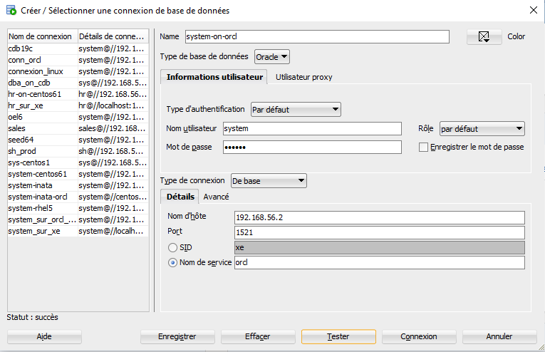
Oracle SQL Developer: créer une connexion

Slide 7
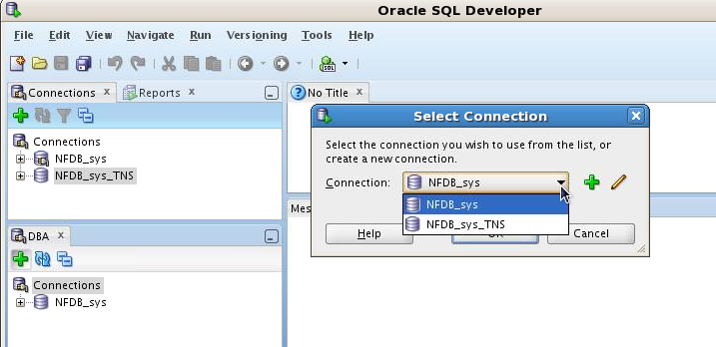
Oracle SQL Developer: Connections
Perform DBA operations in the DBA navigator by using DBA connections:
Notes:
Oracle SQL Developer is a tool that allows stand-alone graphical browsing and development of database schema objects, as well as execution of database administrative tasks.
SQL Developer enables users with database administrator privileges to view and edit certain information relevant to DBAs and perform DBA operations. To perform DBA operations, use the DBA navigator, which is similar to the Connections navigator in that it has nodes for all defined database connections. If the DBA navigator is not visible, select View, then DBA. You should add only connections for which the associated database user has DBA privileges, or at least privileges for the desired DBA navigator operations on the specified database.

Slide 8
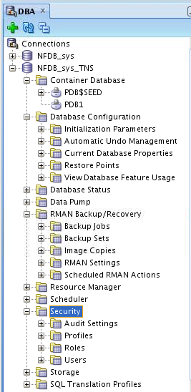
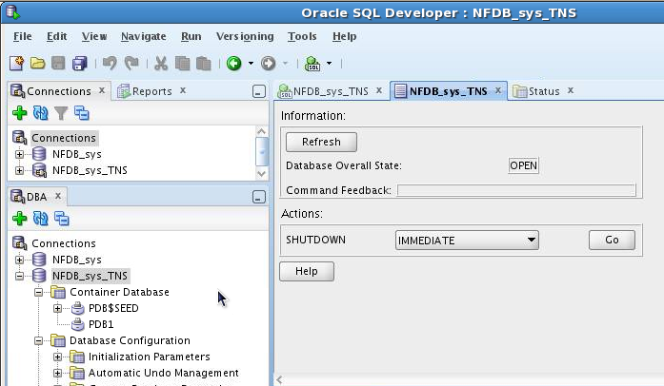
Oracle SQL Developer: DBA Actions
Using DBA features through DBA navigator
Performing DBA actions
Notes:
The DBA operations that can be performed are the following:
Database startup/shutdown
Database configuration: Initialization Parameters, Automatic Undo Management, Current Database Properties, Restore Points, View Database Feature Usage
Database status view
Data Pump export and import jobs
RMAN backup/recovery actions
Resource Manager configuration
Scheduler setting
Security configuration like audit settings, profiles, roles, and users
Storage configuration for archive logs, control files, data files, redo log groups, tablespaces, and temporary tablespace groups

Slide 9
Oracle Enterprise Manager
Database Express
Oracle Enterprise Manager Express is a Web-based interface for
managing a single Oracle database 12c.
Used to perform basic administrative tasks such as
- Managing users
- Managing memory
- Managing storage
- Managing database initialization parameters
- Monitor performance
- View SQL Tuning Advisor information
- Verify status information container database and pluggable
databases

Slide 10
Configuring Enterprise Manager
Database Express
  Configure an HTTP listener port for each database instance.
    Verify DISPATCHERS parameter.
    Use DBMS_XDB.setHTTPPort procedure.
    Launch Enterprise Manager Database Express:
  Use a different port for each instance.
  Browser requires Flash plug-in.
    dispatchers=(PROTOCOL=TCP)(SERVICE=sampleXDB)
    exec DBMS_XDB.setHTTPPort(5500)
    http://hostname:5500/em
Notes:
Oracle Enterprise Manager Database Express is configurable with a single click in Database Configuration Assistant (DBCA).
Enterprise Manager Database Express requires that the XMLDB components are installed. All Oracle version 12.1.0 databases have XMLDB installed.
To activate Enterprise Manager Database Express in a database, verify that the DISPATCHERS initialization parameter has at least one dispatcher configured for the XMLDB service with the TCP protocol.
Use the SETHTTPPORT procedure in the DBMS_XDB package to configure a port on the server. Connect to the Enterprise Manager Database Express console with the URL shown in the slide. Substitute the host name of the server and the port number you set by using the SETHTTPPORT procedure.
If you have multiple database instances to monitor on the same machine, set a different port for each. To find the port used for each database instance, execute the following statement:
SQL> SELECT dbms_xdb.gethttpport FROM DUAL;
Enterprise Manager Database Express uses Shockwave Flash (SWF) files, so the web browser must have the Flash plug-in installed.

Slide 11
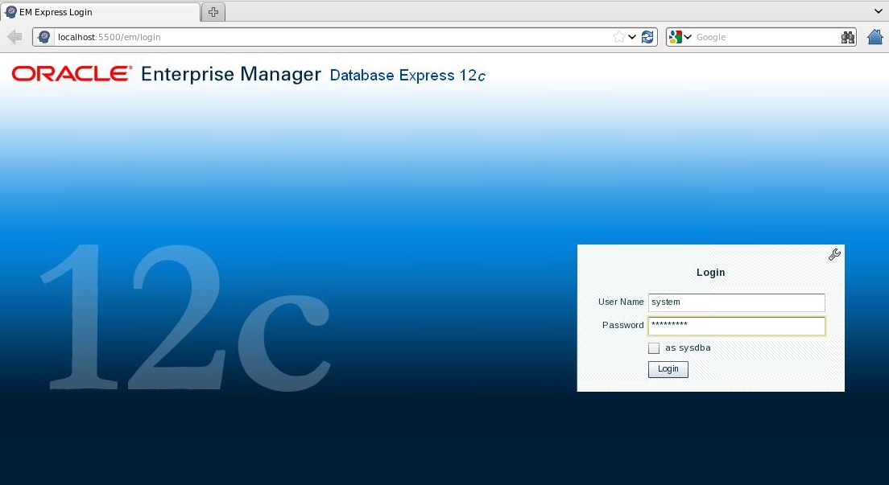
Logging In to Oracle Enterprise Manager Database Express
Notes:
Launch Enterprise Manager Database Express by using the configured HTTP port. Log in as the database user appropriate to the tasks you want to accomplish.

Slide 12
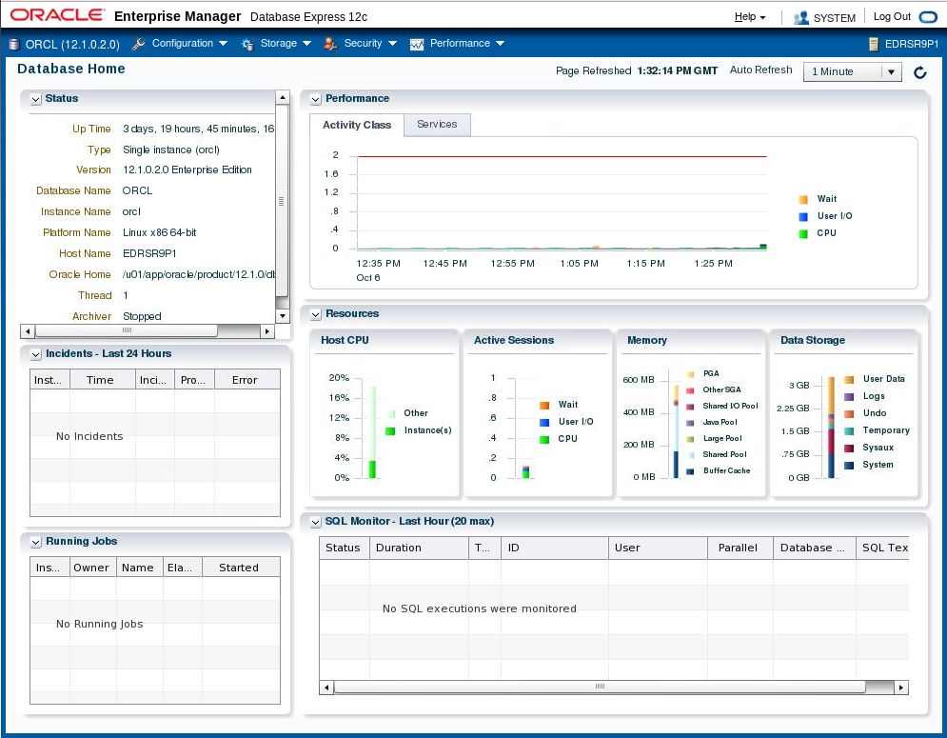
Using the Database Home Page
Notes:
The Enterprise Manager Database Express Home page presents an overall view of the database instance status and activity.

Slide 13



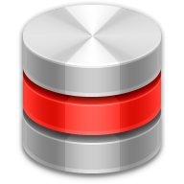










Oracle Enterprise Manager
Cloud Control Components
Oracle Management Agent
Target-specific plug-in
Managed Hosts
Oracle Management Service
Cloud Control Console
Oracle Management Repository
Notes:
Oracle Enterprise Manager Cloud Control is composed of four main components as illustrated in the slide:
Oracle Management Repository (OMR)
Oracle Management Service (OMS)
Oracle Management Agent (OMA or agent) with target-specific plug-ins
Cloud Control Console
The Oracle Management Agent runs on hosts, gathering metric data about those host environments as well as using plug-ins to monitor availability, configuration, and performance and to manage targets running on the host. The agents communicate with the Oracle Management Service to upload metric data collected by them and their plug-ins. In turn, the OMS stores the data it collects in the Oracle Management Repository where it can be accessed by the OMS for automated and manual reporting and monitoring. The OMS also communicates with the agents to orchestrate the management of their monitored targets. As well as coordinating the agents, the OMS runs the Cloud Control Console web pages that are used by administrators and users to report on, monitor, and manage the computing environment that is visible to Cloud Control via the agents and their plug-ins.

Slide 14
Types of Enterprise Manager
Cloud Control Targets
Enterprise Manager Cloud Control can monitor, administer, maintain, and manage many different types of targets including:
  Oracle databases
  Oracle Database Listener
  Oracle Fusion Middleware products
  Oracle Application Server
  Oracle WebLogic Server
  Oracle applications, including E-Business Suite, SOA, Siebel, and PeopleSoft
  Exadata and Exalogic
  Cloud Control Components: OMR and OMS
  Third-party products
Notes:
Targets are the entities that Enterprise Manager Cloud Control manages. To do so, it uses target-type-specific plug-ins and host-specific agents.
Enterprise Manager Cloud Control can monitor, administer, maintain, and manage different types of targets as listed in the slide. As your environment changes, you can add and remove targets from Enterprise Manager Cloud Control as needed. The commonly used Oracle targets (including Enterprise Manager Cloud Control components, such as the OMR and OMS) are predefined as part of the base Enterprise Manager Cloud Control product, but Enterprise Manager Cloud Control has an open API that enables you to create custom targets.

Slide 15
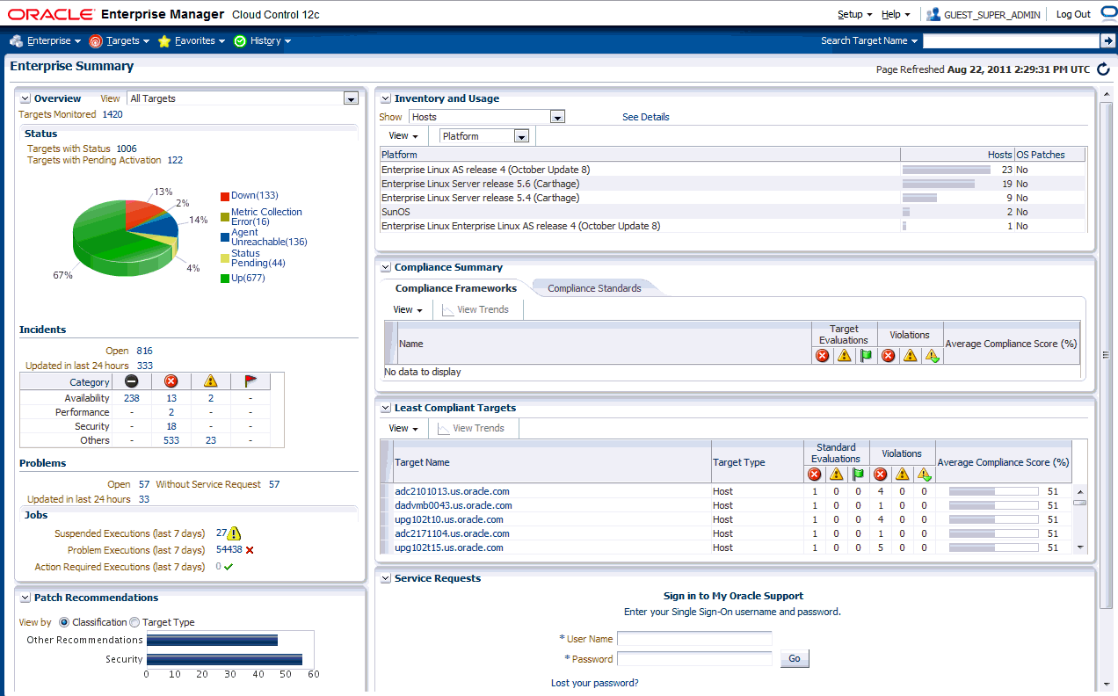
Enterprise Manager Cloud Control
Notes:
The screenshot in the slide is of the Enterprise Summary page of Oracle Enterprise Manager Cloud Control. The user interface (UI) functionality includes:
Information displayed in graphs and tables
Summary information with drilldown capability to relevant details
User-selected home page from a predefined set or based on any page in the console
Menu-driven navigation
Global target search
History and favorites
Customizable target home pages (per-user basis)

Slide 16
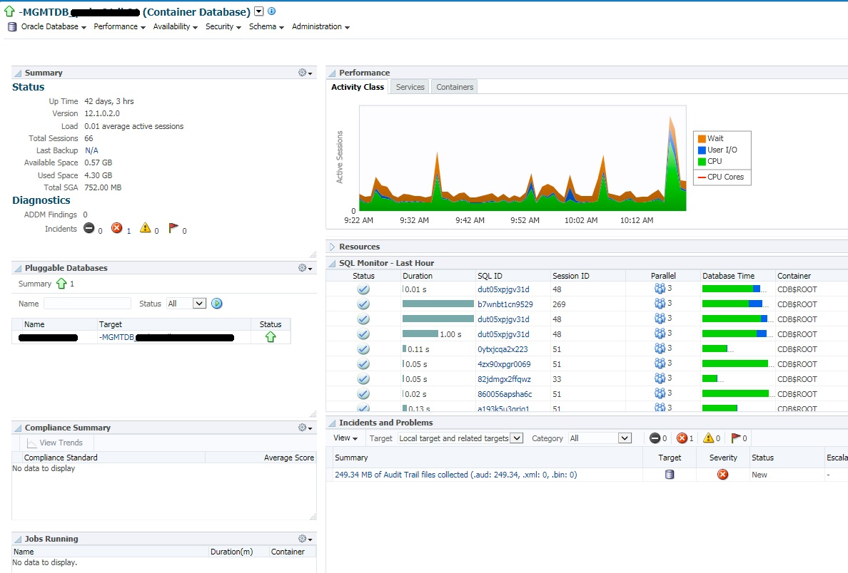
Using Enterprise Manager Cloud Control

